Slide 1
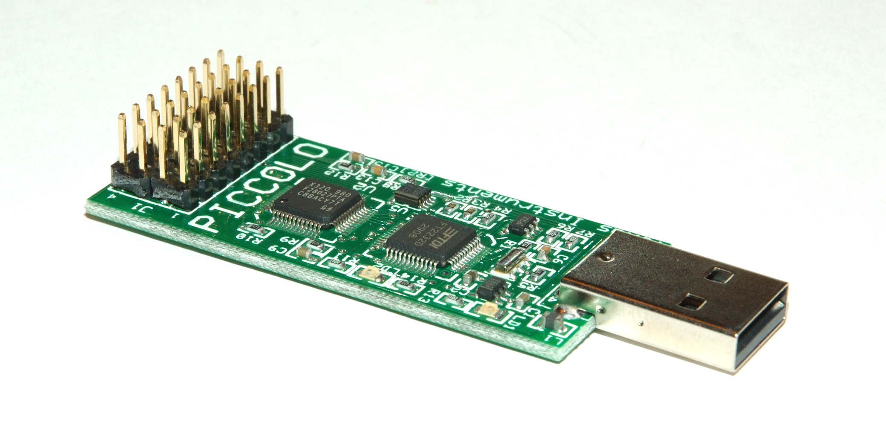
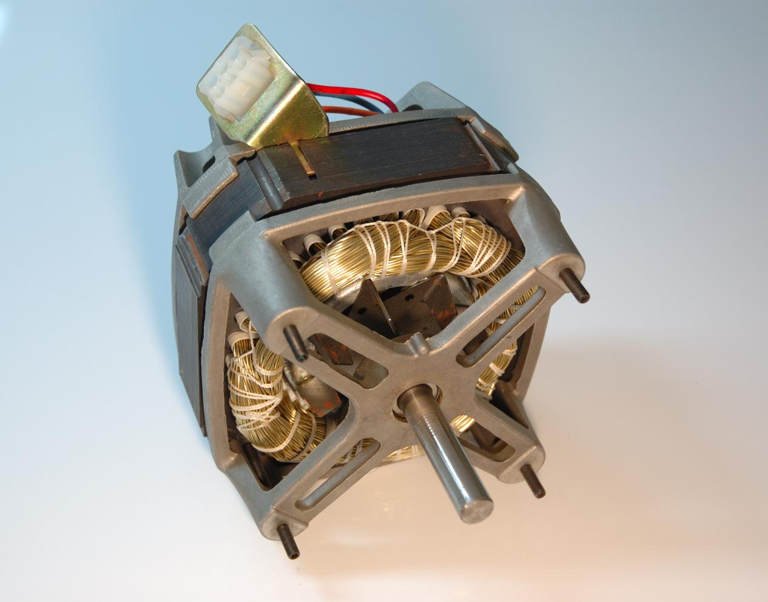

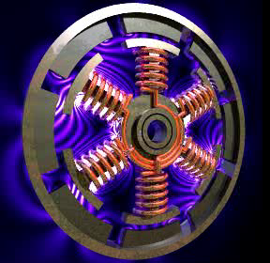
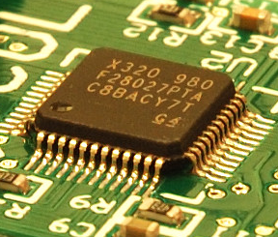

VisSim Lab Exercises
-V_{th}
Dave Wilson
Team Lead, Motor Solutions Group

Slide 2
Lab Exercise #1: Line Started ACIM
In the VisSim folder, open the file “01 ACIM Line Connected”.
This file simulates a three-phase ACIM connected to a 460V AC supply. At t=0, motor speed is also zero.
Click the green “Run” arrow on the toolbar. Watch as the motor starts up.
Once the motor reaches no-load steady-state operation, observe the phase relationship between the motor voltage and motor current.
Increase the motor load by moving the “Load Torque” slider to the right. Once again, observe the phase relationship.

Slide 3

Lab Exercise #1: Line Started ACIM (continued)
Move the load torque slider to the left until you achieve negative torque. Again, observe the phase relationship.
Questions:
Why is the motor current non-zero, even when the load torque is zero? What is this current doing?
What is the power factor of the unloaded induction motor relative to when it is loaded?
What can you say about the relationship between induction motor torque and slip?
What is the relationship between grid power and load torque?
Build a compound block to support your hypothesis, and plot its output. (Joint class exercise)

Slide 4
Lab Exercise #2: PID Position Servo System
In the VisSim folder, open the file “02 PID Control.vsm”.
This simulation shows a PID position controller connected to a Pittman servo motor.
Click the green “Run” arrow on the toolbar.
Adjust the P, I, D, and Integrator Limit values until the following design criteria are met:
A position error of less than 0.01 radians is achieved and maintained within 80 mS.
Position overshoot limited to 0.01 radians or less.
Position error of less than 0.001 radians is achieved and maintained within 120 mS.
The above specs must be maintained throughout the load range of 0 to 1 Newton-Meter.

Slide 5
Lab Exercise #3: FOC of a PMAC Motor
In the VisSim folder, open the file:
“03 PMSM with Digital FOC Control.vsm”
This simulation shows a complete digital FOC controller complete with speed loop driving a Baldor PMSM motor.
Click the green “Run” arrow on the toolbar and observe the motor ramp up to speed.
Questions:
What determines the frequency that the FOC algorithm generates?
Why is the velocity almost a perfect linear ramp?
Open up the load block, and reduce the load’s rotational inertia by a factor of two. Rerun the simulation. What happens?

Slide 6
Lab Exercise #4: Bipolar vs. Unipolar PWMs
In the VisSim folder, open the file:
“04 Bipolar vs Unipolar PWMs.vsm”
This simulation shows two identical motors with identical loads being driven by identical PWM values. However, one is bipolar PWM and the other is unipolar.
Click the green “Run” arrow on the toolbar.
Change the “PWM Value” slider through its entire range. What do you notice about the relative amplitudes of the current ripple? What do you notice about the relative frequencies of the current ripple?
(next slide…)

Slide 7
Lab Exercise #4: (continued)
The right-most graph (which may be off the screen) shows the quadrants of operation of the motor. Set the “PWM Value” slider to 0.3, and set the “Torque Load” slider to zero.
Move the Torque Load slider to the left to move operation into quadrant 4. Does this action result in DC bus regeneration? Why?
Move the Torque Load slider to the right to move operation into quadrant 2. Does this action result in DC bus regeneration? Why?
Adjust the Torque Load slider back and forth. What can you say about the speed-torque curve that a permanent magnet DC motor generates?

Slide 8
Lab Exercise #5: Sliding Mode Observer
In the VisSim folder, open the file:
“05 SMO.vsm”
This simulation shows a Sliding Mode Observer which is very similar to the one used in our C2000 reference designs.
Click the green “Run” arrow on the toolbar.
Observe the SMO’s reconstruction of the motor’s back-EMF signal.
Click the green “Run” arrow again, but this time turn the SMO switching off. How does the reconstruction compare with the switching enabled?
While the simulation is still running, click the “Motor Hot” button. This increases the actual motor resistance by a factor of two. What happens to the observer’s estimate of the back-EMF waveform?

